Slide 1
Copyright © 2014 Pearson Education, Inc.

Slide 2
Chapter 5
E-commerce Security and
Payment Systems
Copyright © 2014 Pearson Education, Inc.

Slide 3
Cyberwar: MAD 2.0
What is the difference between hacking and cyberwar?
Why has cyberwar become more potentially devastating in the past decade?
Why has Google been the target of so many cyberattacks?
Is it possible to find a political solution to MAD 2.0?
Copyright © 2014 Pearson Education, Inc.
Slide 5-<number>

Slide 4
The E-commerce Security Environment
Overall size and losses of cybercrime unclear
  Reporting issues
2011 CSI survey: 46% of respondent firms detected breach in last year
Underground economy marketplace
  Stolen information stored on underground economy servers
Copyright © 2014 Pearson Education, Inc.
Slide 5-<number>

Slide 5
What is Good E-commerce Security?
To achieve highest degree of security
  New technologies
  Organizational policies and procedures
  Industry standards and government laws
Copyright © 2014 Pearson Education, Inc.
Slide 5-<number>

Slide 6
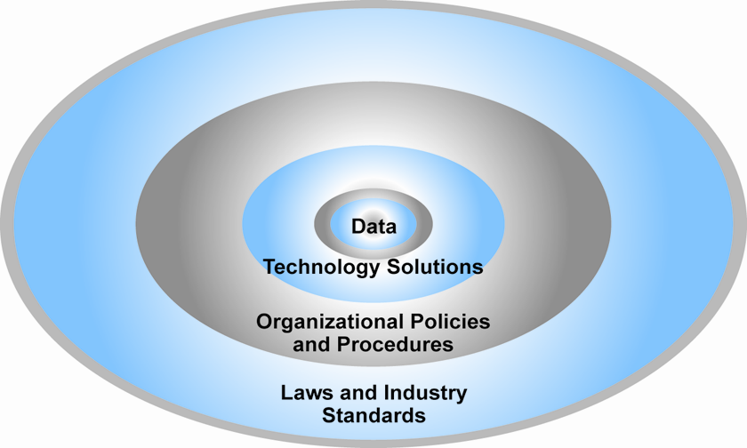
The E-commerce Security Environment
Figure 5.1, Page 168
Copyright © 2014 Pearson Education, Inc.
Slide 5-<number>

Slide 7
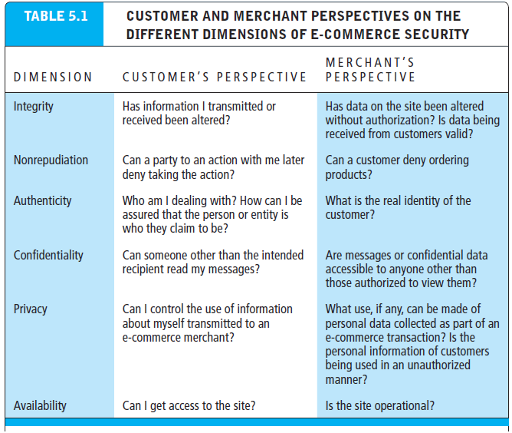
Table 5.1, Page 169
Copyright © 2014 Pearson Education, Inc.
Slide 5-<number>

Slide 8
Security Threats in the
E-commerce Environment
Three key points of vulnerability in e-commerce environment:
  Client
  Server
  Communications pipeline (Internet communications channels)
Copyright © 2014 Pearson Education, Inc.
Slide 5-<number>

Slide 9
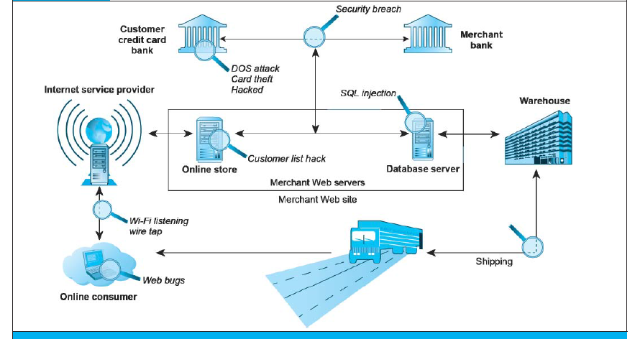
Vulnerable Points in an E-commerce Transaction
Figure 5.2, Page 170
Copyright © 2014 Pearson Education, Inc.
Slide 5-<number>

Slide 10
Most Common Security Threats in the
E-commerce Environment
Malicious code
  Viruses
  Worms
  Trojan horses
  Drive-by downloads
  Backdoors
  Bots, botnets
  Threats at both client and server levels
Copyright © 2014 Pearson Education, Inc.
Slide 5-<number>

Slide 11
Most Common Security Threats (cont.)
Potentially unwanted programs (PUPs)
  Browser parasites
  Adware
  Spyware
Phishing
  E-mail scams
  Social engineering
  Identity theft
Copyright © 2014 Pearson Education, Inc.
Slide 5-<number>

Slide 12
Most Common Security Threats (cont.)
Hacking
  Hackers vs. crackers
  Types of hackers: White, black, grey hats
  Hacktivism
Cybervandalism
  Disrupting, defacing, destroying Web site
Data breach
  Losing control over corporate information to outsiders
Copyright © 2014 Pearson Education, Inc.
Slide 5-<number>

Slide 13
Most Common Security Threats (cont.)
Credit card fraud/theft
  Hackers target merchant servers; use data to establish credit under false identity
Spoofing (Pharming)
Spam (junk) Web sites
Denial of service (DoS) attack
  Hackers flood site with useless traffic to overwhelm network
Distributed denial of service (DDoS) attack
Copyright © 2014 Pearson Education, Inc.
Slide 5-<number>

Slide 14
Most Common Security Threats (cont.)
Sniffing
  Eavesdropping program that monitors information traveling over a network
Insider attacks
Poorly designed server and client software
Social network security issues
Mobile platform security issues
  Same risks as any Internet device
Cloud security issues
Copyright © 2014 Pearson Education, Inc.
Slide 5-<number>

Slide 15
Think Your Smartphone Is Secure?
What types of threats do smartphones face?
Are there any particular vulnerabilities to this type of device?
Are apps more or less likely to be subject to threats than traditional PC software programs?
Copyright © 2014 Pearson Education, Inc.
Slide 5-<number>

Slide 16
Technology Solutions
Protecting Internet communications
  Encryption
Securing channels of communication
  SSL, VPNs
Protecting networks
  Firewalls
Protecting servers and clients
Copyright © 2014 Pearson Education, Inc.
Slide 5-<number>

Slide 17
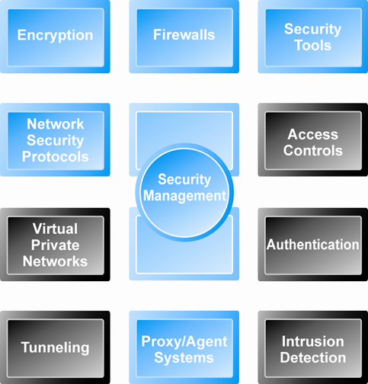
Tools Available to Achieve Site Security
Figure 5.4, Page 181
Copyright © 2014 Pearson Education, Inc.
Slide 5-<number>

Slide 18
Encryption
Encryption
  Transforms data into cipher text readable only by sender and receiver
  Secures stored information and information transmission
  Provides 4 of 6 key dimensions of e-commerce security
    Message integrity
    Nonrepudiation
    Authentication
    Confidentiality
Copyright © 2014 Pearson Education, Inc.
Slide 5-<number>

Slide 19
Symmetric Key Encryption
Sender and receiver use same digital key to encrypt and decrypt message
Requires different set of keys for each transaction
Strength of encryption
  Length of binary key used to encrypt data
Advanced Encryption Standard (AES)
  Most widely used symmetric key encryption
  Uses 128-, 192-, and 256-bit encryption keys
Other standards use keys with up to 2,048 bits
Copyright © 2014 Pearson Education, Inc.
Slide 5-<number>

Slide 20
Public Key Encryption
Uses two mathematically related digital keys
  Public key (widely disseminated)
  Private key (kept secret by owner)
Both keys used to encrypt and decrypt message
Once key used to encrypt message, same key cannot be used to decrypt message
Sender uses recipient’s public key to encrypt message; recipient uses private key to decrypt it
Copyright © 2014 Pearson Education, Inc.
Slide 5-<number>

Slide 21
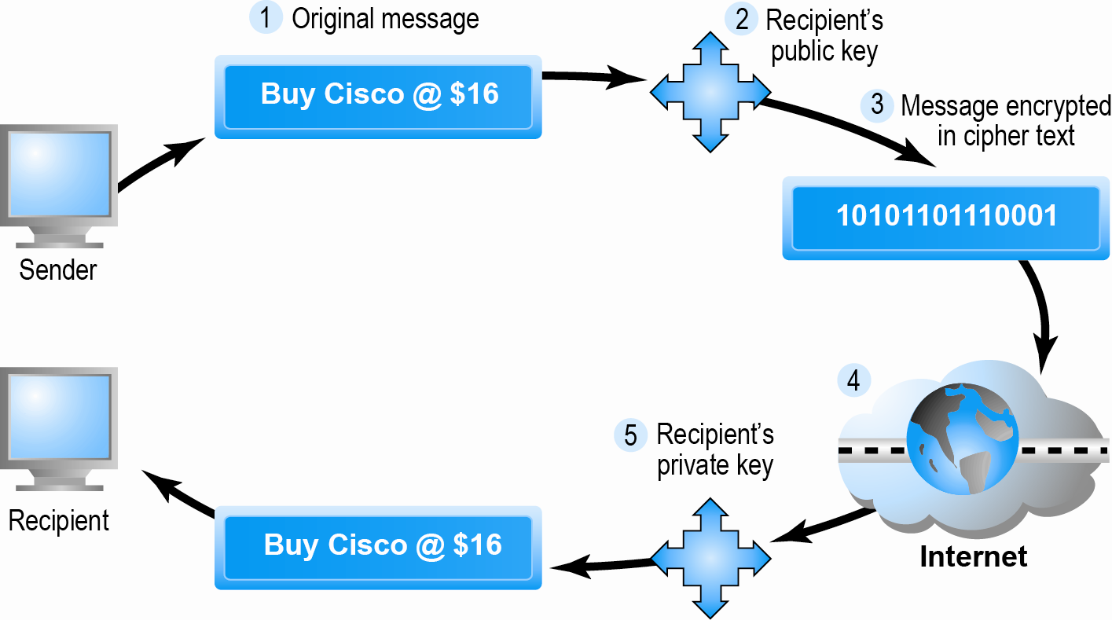
Public Key Cryptography: A Simple Case
Figure 5.5, Page 184
Copyright © 2014 Pearson Education, Inc.
Slide 5-<number>

Slide 22
Public Key Encryption Using Digital Signatures and Hash Digests
Hash function:
  Mathematical algorithm that produces fixed-length number called message or hash digest
Hash digest of message sent to recipient along with message to verify integrity
Hash digest and message encrypted with recipient’s public key
Entire cipher text then encrypted with recipient’s private key—creating digital signature—for authenticity, nonrepudiation
Copyright © 2014 Pearson Education, Inc.
Slide 5-<number>

Slide 23
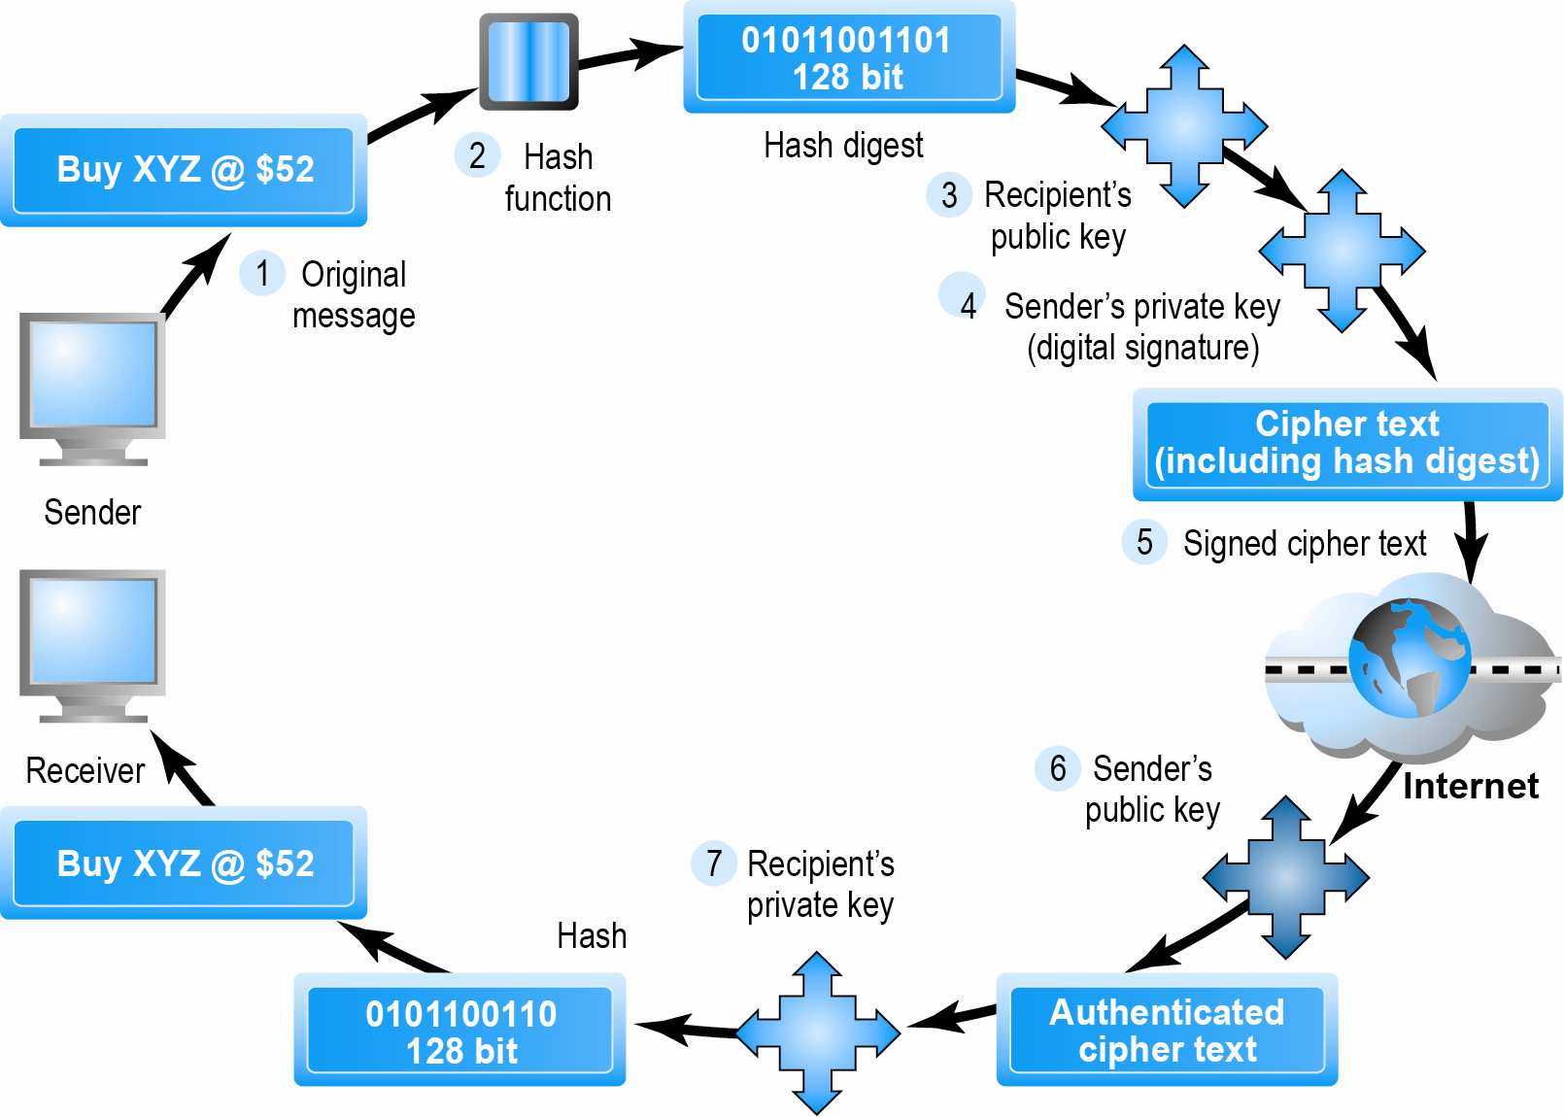
Public Key Cryptography with Digital Signatures
Figure 5.6, Page 185
Copyright © 2014 Pearson Education, Inc.
Slide 5-<number>

Slide 24
Digital Certificates and
Public Key Infrastructure (PKI)
Digital certificate includes:
  Name of subject/company
  Subject’s public key
  Digital certificate serial number
  Expiration date, issuance date
  Digital signature of CA
Public Key Infrastructure (PKI):
  CAs and digital certificate procedures
  PGP
Copyright © 2014 Pearson Education, Inc.
Slide 5-<number>

Slide 25
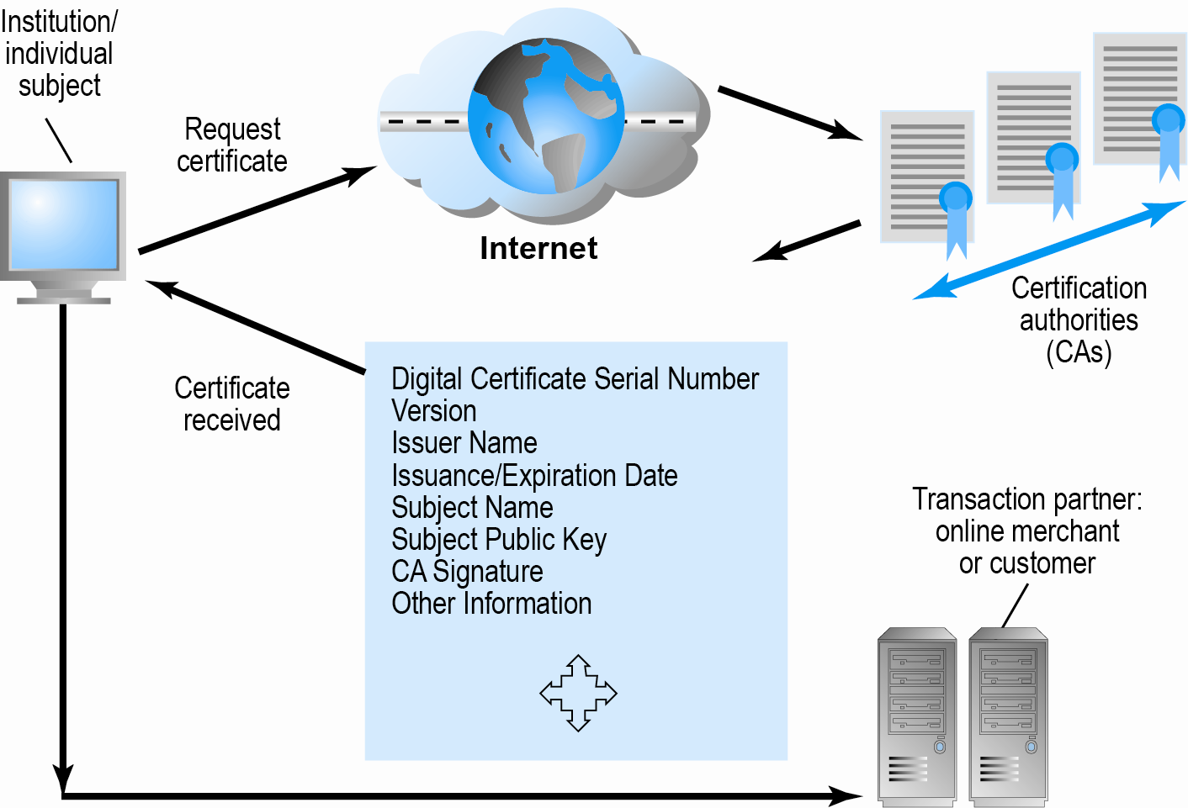
Digital Certificates and Certification Authorities
Figure 5.7, Page 187
Copyright © 2014 Pearson Education, Inc.
Slide 5-<number>

Slide 26
Limits to Encryption Solutions
Doesn’t protect storage of private key
  PKI not effective against insiders, employees
  Protection of private keys by individuals may be haphazard
No guarantee that verifying computer of merchant is secure
Copyright © 2014 Pearson Education, Inc.
Slide 5-<number>

Slide 27
Web Dogs and Anonymity: Identity 2.0
What are some of the benefits of continuing the anonymity of the Internet?
Who are the groups involved in creating an identity system for the Internet?
Who should control a central identity system?
Copyright © 2014 Pearson Education, Inc.
Slide 5-<number>

Slide 28
Securing Channels of Communication
Secure Sockets Layer (SSL) and Transport Layer Security (TLS)
  Establishes a secure, negotiated client-server session in which URL of requested document, along with contents, is encrypted
Virtual Private Network (VPN)
  Allows remote users to securely access internal network via the Internet
Copyright © 2014 Pearson Education, Inc.
Slide 5-<number>

Slide 29
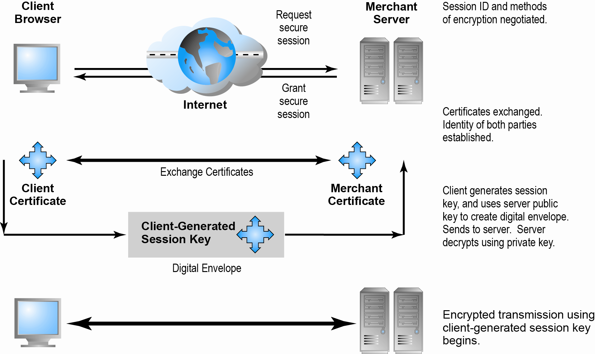
Secure Negotiated Sessions Using SSL/TLS
Figure 5.8, Page 189
Copyright © 2014 Pearson Education, Inc.
Slide 5-<number>

Slide 30
Protecting Networks
Firewall
  Hardware or software
  Uses security policy to filter packets
Proxy servers (proxies)
  Software servers that handle all communications originating from or being sent to the Internet
Copyright © 2014 Pearson Education, Inc.
Slide 5-<number>

Slide 31
Protecting Servers and Clients
Operating system security enhancements
  Upgrades, patches
Anti-virus software
  Easiest and least expensive way to prevent threats to system integrity
  Requires daily updates
Copyright © 2014 Pearson Education, Inc.
Slide 5-<number>

Slide 32
E-commerce Payment Systems
Credit cards
  Still the dominant online payment method in United States
Limitations of online credit card payment systems
  Security, merchant risk
  Cost
  Social equity
Copyright © 2014 Pearson Education, Inc.
Slide 5-<number>

Slide 33
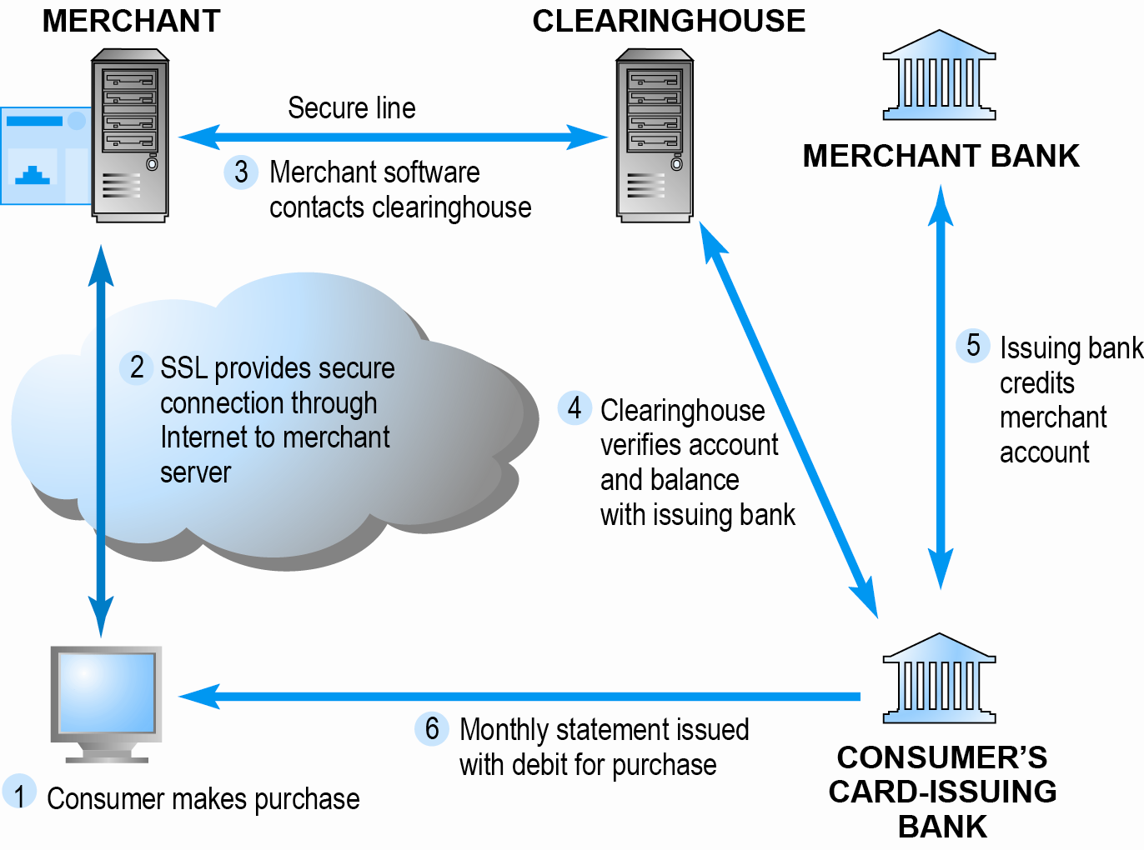
How an Online Credit Transaction Works
Figure 5.10, Page 193
Copyright © 2014 Pearson Education, Inc.
Slide 5-<number>

Slide 34
Alternative Online Payment Systems
Online stored value systems
  Based on value stored in a consumer’s bank, checking, or credit card account
  e.g.: PayPal
Other alternatives
  Amazon Payments
  Google Checkout
Copyright © 2014 Pearson Education, Inc.
Slide 5-<number>

Slide 35
Mobile Payment Systems
Use of mobile phones as payment devices established in Europe, Japan, South Korea
Near field communication (NFC)
  Short-range (2”) wireless for sharing data between devices
Expanding in United States
  Google Wallet
    Mobile app designed to work with NFC chips
  PayPal
  Square
Copyright © 2014 Pearson Education, Inc.
Slide 5-<number>

Slide 36
Digital Cash and Virtual Currencies
Digital cash
  Based on algorithm that generates unique tokens that can be used in “real” world
  e.g.: Bitcoin
Virtual currencies
  Circulate within internal virtual world
  e.g.: Linden Dollars in Second Life, Facebook Credits
Copyright © 2014 Pearson Education, Inc.
Slide 5-<number>

Slide 37
Electronic Billing Presentment and Payment (EBPP)
Online payment systems for monthly bills
50% of all bill payments
Two competing EBPP business models:
  Biller-direct (dominant model)
  Consolidator
Both models are supported by EBPP infrastructure providers
Copyright © 2014 Pearson Education, Inc.
Slide 5-<number>

Slide 38
Copyright © 2014 Pearson Education, Inc.
Slide 5-<number>

